Slide 1

Swensons
01-03-2017

Slide 2
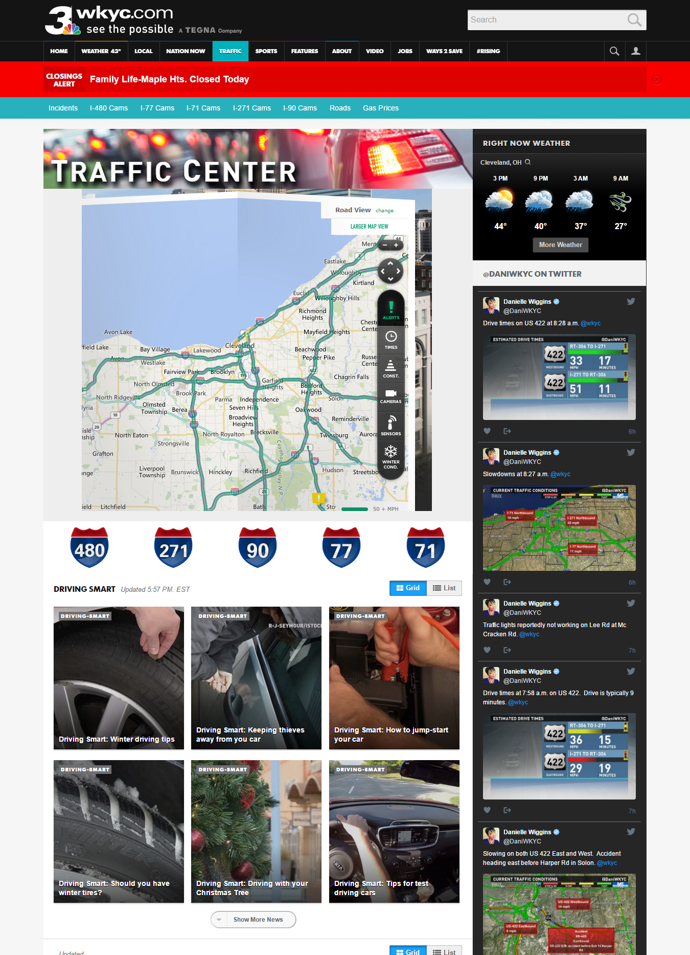
http://www.wkyc.com/traffic

Slide 3
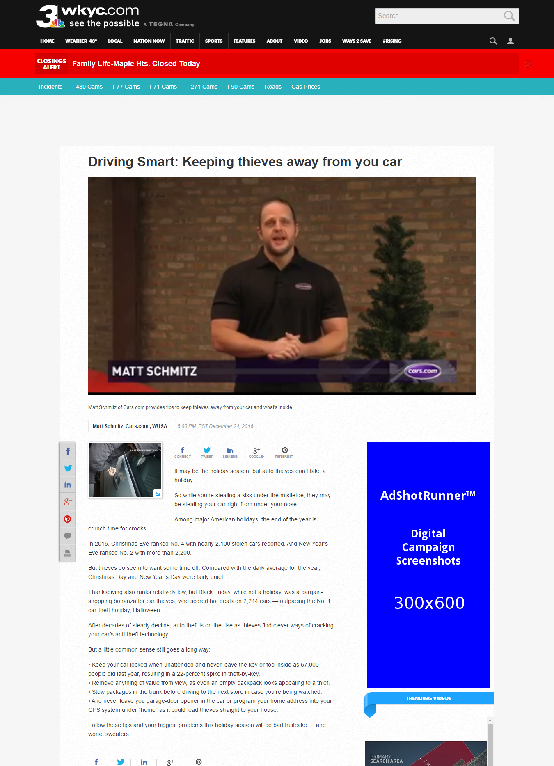
http://www.wkyc.com/traffic/driving-smart/driving-smart-keeping-thieves-away-from-you-car/376765650

Slide 4
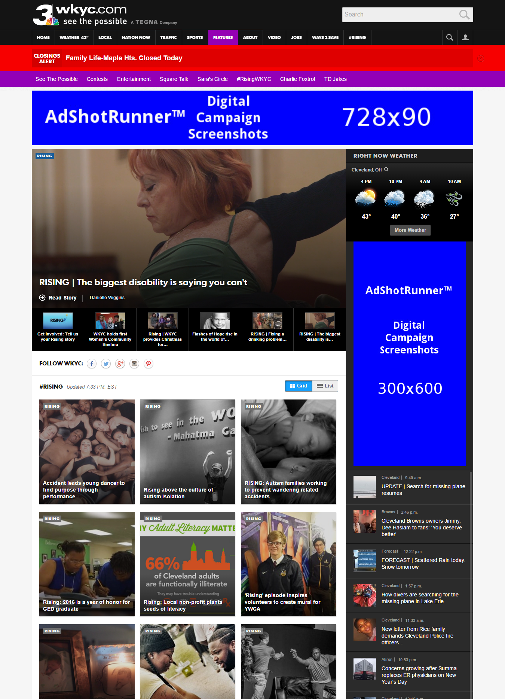
http://www.wkyc.com/features/rising

Slide 5
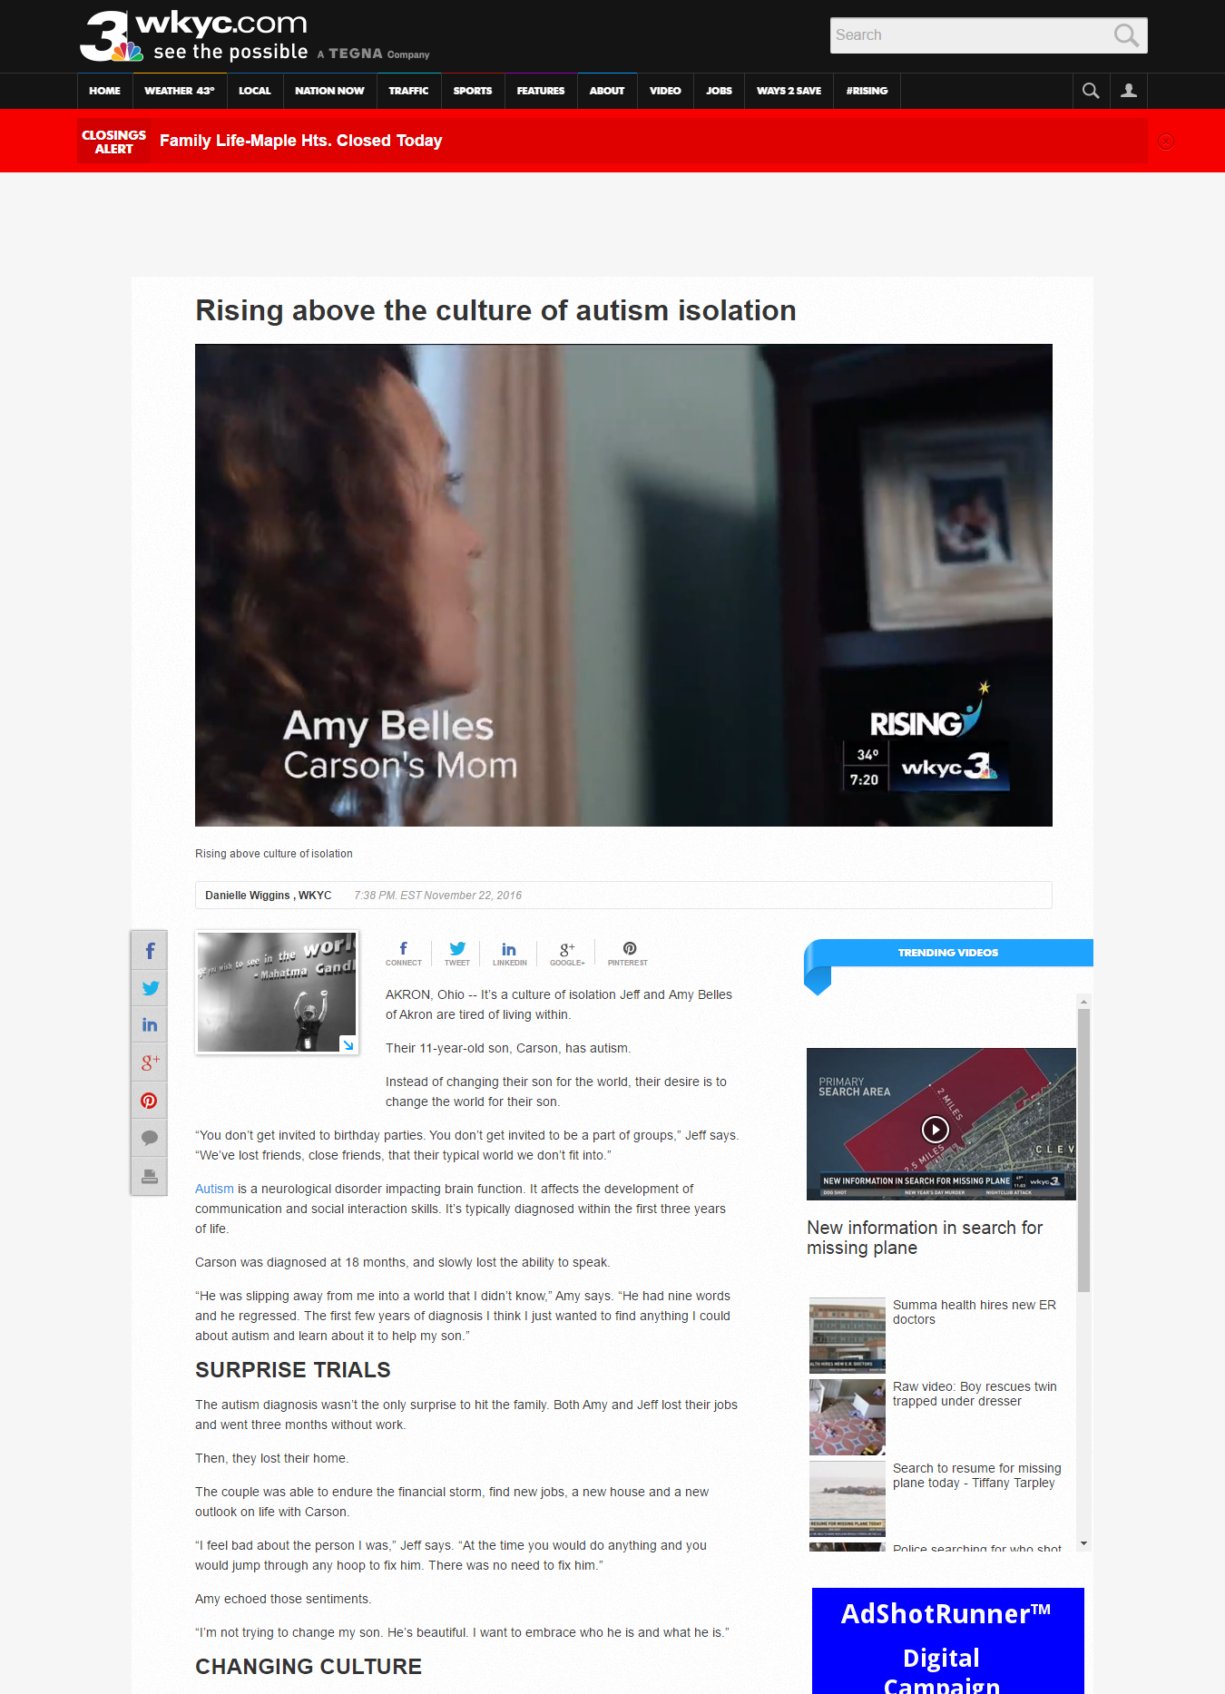
http://www.wkyc.com/entertainment/television/programs/rising/rising-above-the-culture-of-autism-isolation/354911843

